Slide 1


Understanding Variables and Data Types in C++
Welcome to our exploration of variables and data types in C++. We'll cover the basics, helping you build a solid foundation for your programming journey.
by ILYAS SHAIKH CREATIONS

Slide 2
What are Variables?
Containers for Information
Dynamic Values
Variables act as containers for holding information. They are named storage locations that can store different values throughout your program.
Variables allow you to store and manipulate data that can change over time. They are essential for writing programs that can handle different inputs and produce diverse outputs.

Slide 3
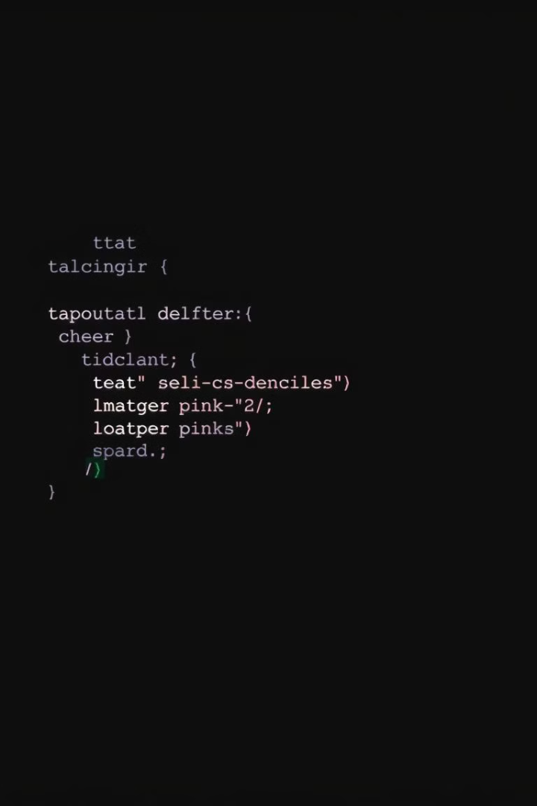
Declaring Variables in C++
1
Defining Data Type
2
Assigning a Name
First, you declare the data type of the variable. This tells the compiler what type of information the variable can hold.
You then give the variable a meaningful name. Use descriptive names that reflect the variable's purpose.
3
Using the Semicolon
Finally, end the declaration with a semicolon (;). This indicates the end of the statement to the compiler.

Slide 4




Assigning Values to Variables
Assignment Operator
Use the assignment operator (=) to store a value into a declared variable.
Direct Value Assignment
You can assign a literal value directly to a variable. For example: age = 25;
Variable Assignment
Values can be assigned from other variables. For example: myNumber = anotherNumber;

Slide 5
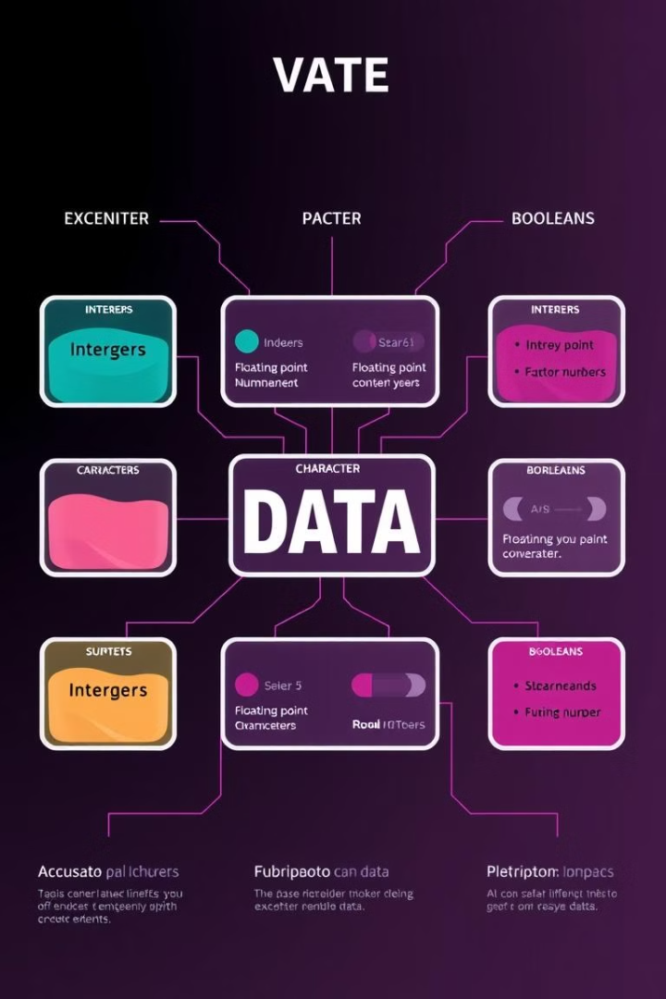
Understanding Data Types
Integer Data Types
Floating-Point Data Types
Represent whole numbers without decimal places, such as -10, 0, 5, 100.
Represent numbers with decimal places, like 3.14, -2.5, 12.0.
Character Data Types
Boolean Data Types
Store single characters, such as 'A', '!', '9'.
Represent true or false values.

Slide 6
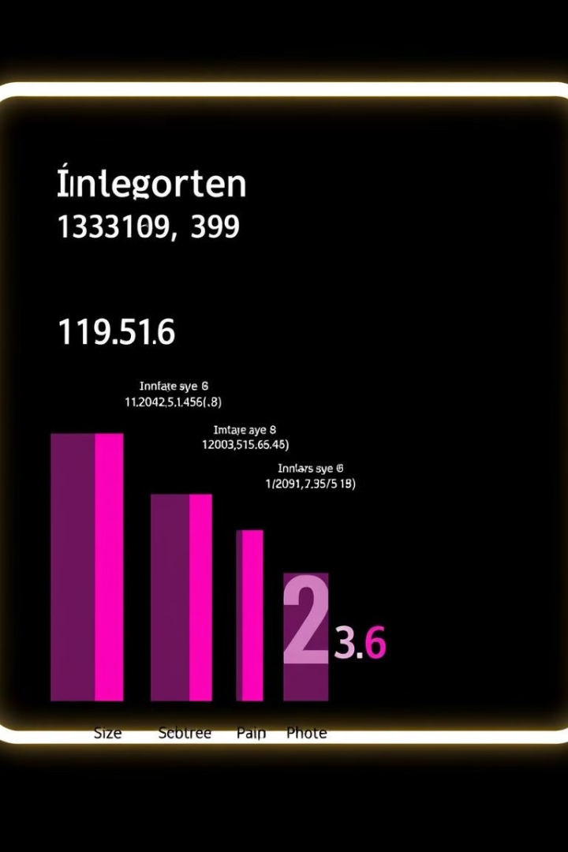




Exploring Integer Data Types
int
short
The most common integer type. It represents whole numbers within a specified range, often -32,768 to 32,767.
A smaller integer type that can store values within a smaller range.
long
long long
A larger integer type that can store values within a wider range than an int.
The largest integer type in C++. It can store values over a very wide range.

Slide 7

Floating-Point Data Types
float
double
float
double
Single-precision floating-point numbers, used for storing decimal numbers with a smaller range and precision.
Double-precision floating-point numbers, which offer a wider range and higher precision for storing decimal values.

Slide 8



Character Data Types
char
1
Stores a single character value, like 'A', '!', or '9'.
ASCII Encoding
2
Characters are represented by numerical values using the ASCII (American Standard Code for Information Interchange) system.
Wide Characters
3
For representing a wider range of characters, such as those found in different languages, you can use the wchar_t data type.

